Slide 1
Fast Track to the World of Ideas
Jeff Myers, Ph.D.
Notes:
Summit’s mission is to equip and support the rising generation to embrace God’s truth and champion a biblical worldview.

Slide 2
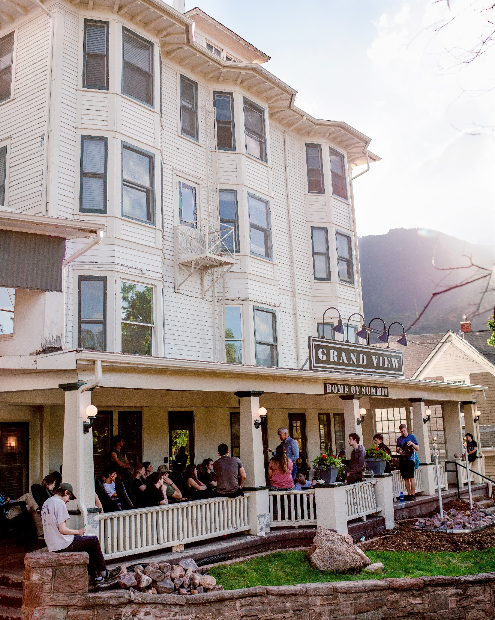
Summit Ministries
Equipping the rising generation to embrace God’s truth and champion a biblical worldview
Notes:
Preparing a Generation to Love the Gospel and Stand for Truth

Slide 3
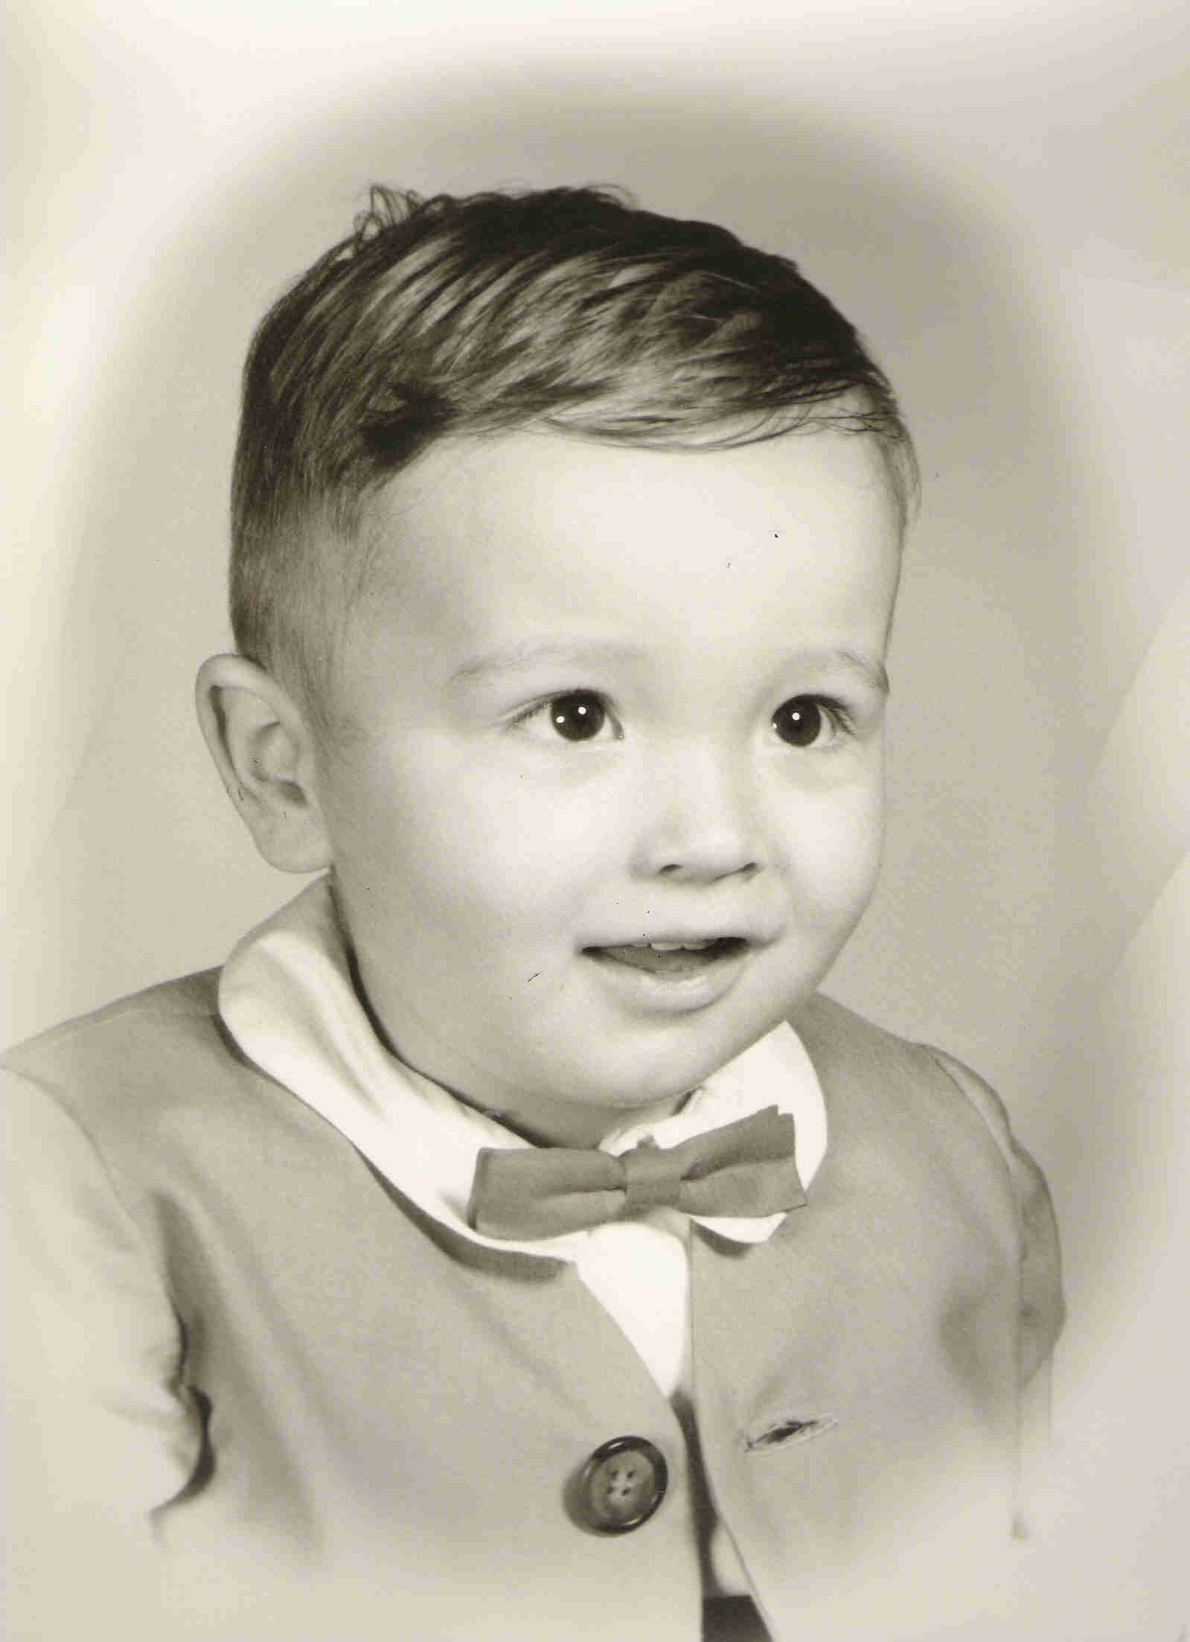
Notes:
43 dead, 1,189 injured, 7,200 arrests, and 2,000 buildings destroyed

Slide 4
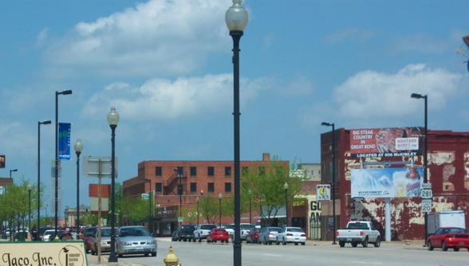
Notes:
Seemed like a paradise. Calm, hard-working people, kinder, less pretentious. Productive. Focused on others.

Slide 6
How do we find meaning in a fleeting life?
Notes:
One out of every one person dies
75% of young adults say that have no purpose that gives them meaning in life
53% of young adults say they regularly struggle with anxiety and depression

Slide 7
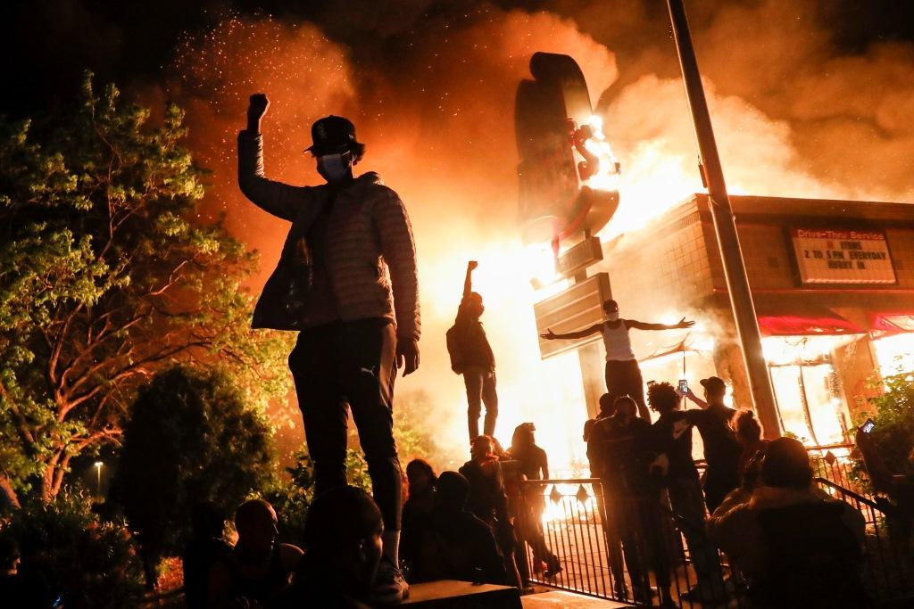

Slide 9
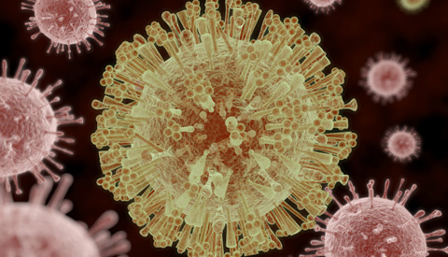
Bad ideas are like viruses
Notes:
Colossians 2:8 See to it that no one takes you captive by philosophy and empty deceit, according to human tradition, according to the elemental spirits of the world, and not according to Christ.
Churches report growth in virtual attendance
Black death—spirituality grew in some areas—not growth in church attendance but growth of interior spiritual life
https://www.firstthings.com/web-exclusives/2020/04/covid-19-and-the-spiritual-life

Slide 10
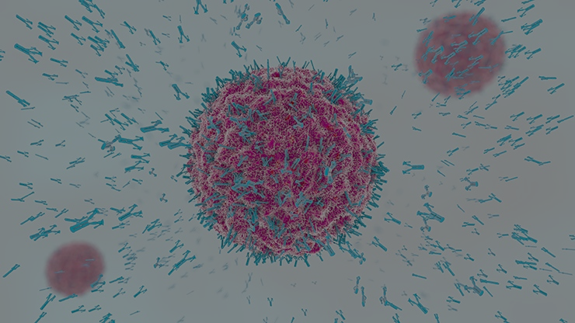
We need spiritual antibodies
Notes:
Our bodies produce “antibodies” which swoop in and mark viruses, targeting them for destruction by white blood cells
1 Peter 1:13 Therefore, preparing your minds for action, and being sober-minded, set your hope fully on the grace that will be brought to you at the revelation of Jesus Christ.
Colossians 2:8 See to it that no one takes you captive by philosophy and empty deceit, according to human tradition, according to the elemental spirits of the world, and not according to Christ.

Slide 11
Colossians 2:8
“See to it that no one takes you captive by philosophy and empty deceit, according to human tradition, according to the elemental spirits of the world, and not according to Christ.”
Notes:
Our bodies produce “antibodies” which swoop in and mark viruses, targeting them for destruction by white blood cells
1 Peter 1:13 Therefore, preparing your minds for action, and being sober-minded, set your hope fully on the grace that will be brought to you at the revelation of Jesus Christ.
Colossians 2:8 See to it that no one takes you captive by philosophy and empty deceit, according to human tradition, according to the elemental spirits of the world, and not according to Christ.

Slide 12
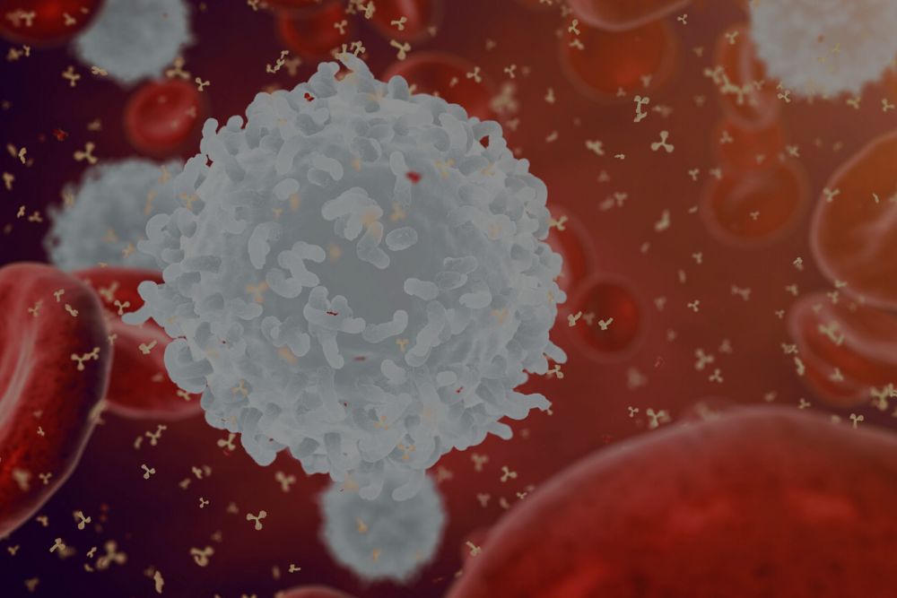
We need spiritual white blood cells
Notes:
White blood cells
2 Corinthians 10:5 We destroy arguments and every lofty opinion raised against the knowledge of God, and take every thought captive to obey Christ,

Slide 13
2 Corinthians 10:5
“We destroy arguments and every lofty opinion raised against the knowledge of God, and take every thought captive to obey Christ.”
Notes:
White blood cells
2 Corinthians 10:5 We destroy arguments and every lofty opinion raised against the knowledge of God, and take every thought captive to obey Christ,

Slide 14
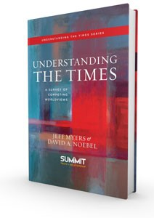
Worldview:
A pattern of ideas about God and life.

Slide 15
Notes:
Why these six? The goal of understanding patterns is not to understand everything, any more than that to understand people we have to meet every person. We want to understand the dominant patterns of the day.
London Telegraph: 176,632 people in England and Wales consider themselves, in their religious affiliation, to be Jedi warriors. Another 6,242
say they worship heavy metal music.
Why not engineering? Because the battle of ideas doesn’t rage in engineering (imagine engineers debating whether 2 + 2 = 4 is true or just a social construct)

Slide 16
Secularism: Matter
The physical universe is all there is; humanity is broken because of ignorance. Redemption comes through science, not religion.

Slide 17
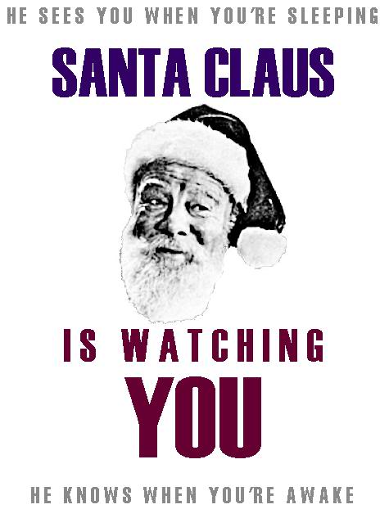

Slide 19
New Spirituality: Oneness
Everything that exists is an impersonal spiritual force that we call “God”; humanity is broken because of selfishness. Redemption comes by ridding ourselves of ego and melting into the oneness of all things.
Notes:
What we call “New Spirituality” is often referred to as the New Age Movement, neo-paganism, new consciousness, or just “spirituality.” New Spirituality’s influences range from Hinduism and Buddhism to the personal introspection of Ralph Waldo Emerson and Henry David Thoreau, with a good dose of pop psychology thrown in.
New Spiritualists talk about God and Jesus Christ in such positive terms that some people are convinced the New Spiritualist worldview is basically Christian. But it isn’t. New Spirituality is committed to a radically un-Christian view of the world, the nature of God, and the purpose of human beings in this world and the next.
If you can understand three things, you’ll have a pretty good grasp of what New Spirituality is all about:
Motions:
Everything is spirit (arms out wide)
God is within (point to self)
Life is the search for higher consciousness (meditation stance)
Oneness brings unity, which solves the world’s problems (hug)

Slide 20
Notes:
"The Force is what gives a Jedi his power. It's an energy field created by all living things. It surrounds us and penetrates us. It binds the galaxy together."

Slide 21
Marxism: Revolution
The physical universe is all there is; humanity is broken because the rich took more than their fair share. Redemption comes through overthrowing society’s structures and moving toward communism.

Slide 22
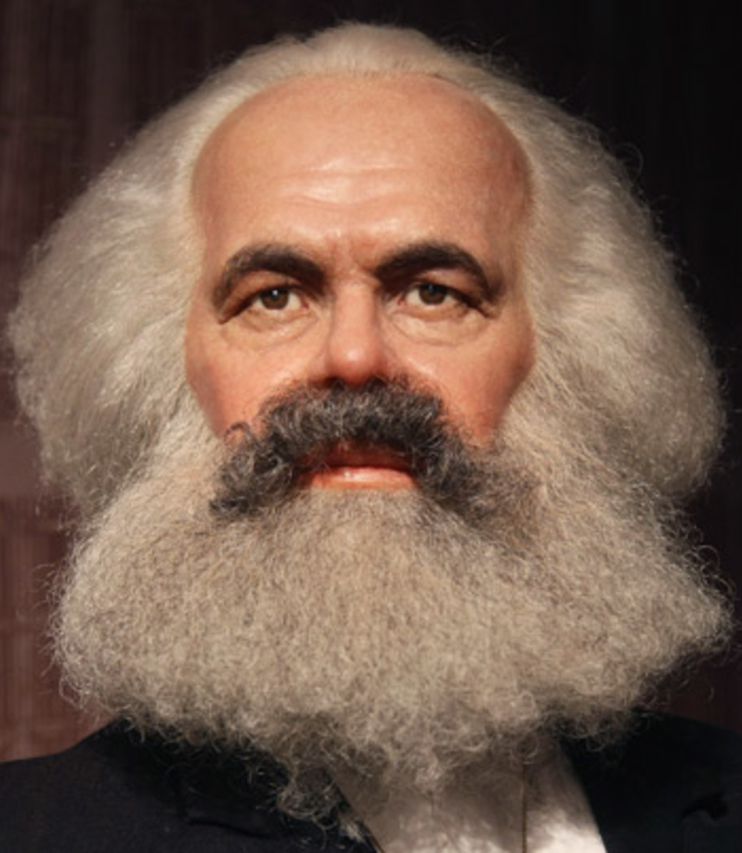
Karl Marx, Communist Manifesto
“The Communists disdain to conceal their views and aims. They openly declare that their ends can be attained only by the forcible overthrow of all existing social conditions. Let the ruling classes tremble at a communist revolution. The proletarians have nothing to lose but their chains. They have a world to win. Proletarians of all countries, unite!”

Slide 23
Islam: Submission
There is a God named Allah who is the creator of the universe. Humanity is broken because it has strayed from its original state of Islam—submission. Redemption comes through Jihad, which is the spiritual struggle against sin.

Slide 24
Postmodernism: Suspicion
The physical universe is all there is; humanity is broken because those in power force everyone else to submit to their idea of ultimate truth. Redemption comes through regarding all such claims with suspicion and focusing instead on our own socially-constructed personal experiences.

Slide 25
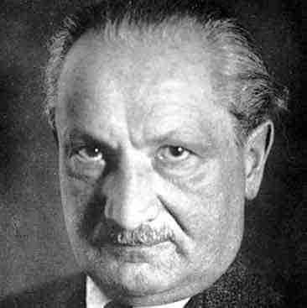
Martin Heidegger
“In the naming, the things named are called into their thinging. Thinging, they unfold world, in which things abide, and so are the abiding ones. By thinging, things carry out world.”
Notes:
Martin Heidegger, Poetry, Language, Thought (New York: Harper, 2001), 197.

Slide 26
Christianity: Healing
God is the Eternal Creator who created both the spiritual and material world and made human beings in his image. Humanity is broken because of sin. Jesus’s redemption makes it possible for us to experience healing and bring healing to every aspect of society.

Slide 27
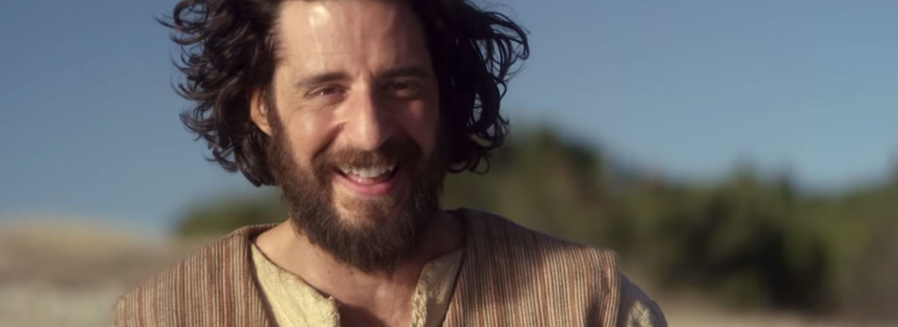
“I am the way and the truth and the life, and no one comes to the father but through me.”
John 14:6

Slide 28
What did Jesus claim to be?
?

Slide 29
The Way (the good): A moral course of action
Notes:
Biblical worldview is not true because it is good, it is good because it is true. It throws open reality and enables us to see it from God’s perspective

Slide 30
Christians, acting on biblical beliefs…
…advanced human rights
…brought about the abolition of slavery
…secured the basis for women’s and children’s rights
…established modern education
…formed the practice of modern medicine
…instituted principles of modern charity
…built the foundations of modern science
…shaped the arts
Notes:
Rights-Treating people with dignity as image-bearers of God-William of Ockham argued that rights should be based on real things; Locke-based on Genesis creation
Slavery-Promoting the unalienable right to liberty-Paul treated slaves as brothers, fellow-workers; Luke; Onesimus; early 1700s…Wilberforce, Hannah Moore, Thomas Clarke, Olaudah Equiano
Women and children-Rome was anti-woman
Education: St. Columbanus; Charlemaigne-got Alcuin of York; Geert Groote (Netherlands)
Modern medicine: Roman plague, black plague, Catholic church, but also Moravian Brethren
Charity-Christianity saw mercy and charity as virtues, not vices, as philosophers had done
Science: 52 active scientists as “founders”—only one was an atheist, more than 60% devout Christians (Edmund Halley was the atheist—or at least a skeptic). Robert Grosseteste 1170-1253 developed scientific method—didn’t just want to reason ABOUT the world—wanted to look AT it (Roger Bacon was one of his students)
Arts: Chr influence gave us David and Messiah; secularism gave us Marcel Duchamp’s urinal. Chr believed in intrinsic spiritual aspect of reality. Creation, fall, redemption in stories—music.

Slide 31
The Truth (the true): The source of what can be known
Notes:
The biblical worldview is true in that it reflects reality as it really is
John 8:32—you will know the truth (alatheia)=reality
TRUTH versus truths

Slide 32
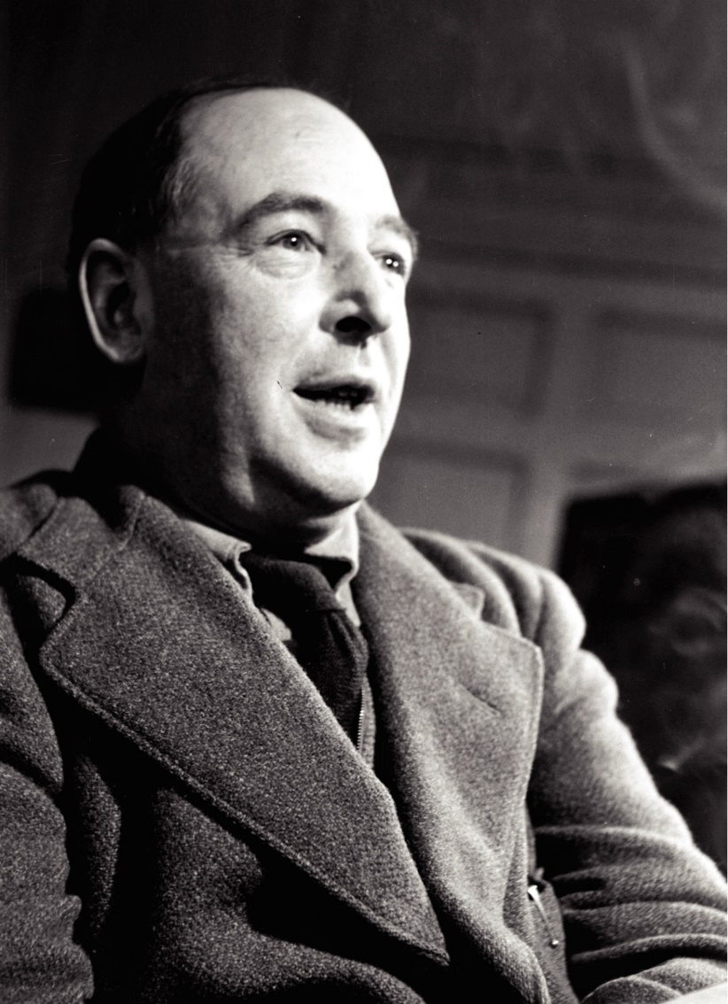
C.S. Lewis, Broadcast Talks
“Suppose there were no intelligence behind the universe. In that case nobody designed my brain for the purpose of thinking. Thought is merely the by-product of some atoms within my skull. But if so, how can I trust my own thinking to be true?…

Slide 33
C.S. Lewis, Broadcast Talks
But if I can’t trust my own thinking, of course, I can’t trust the arguments leading to atheism, and therefore have no reason to be an atheist, or anything else. Unless I believe in God, I can’t believe in thought; so I can never use thought to disbelieve in God.”

Slide 34
The Life (the beautiful): The key to meaningful life
Notes:
Life = Zoe: dz-O-ay

Slide 35
C.S. Lewis, Broadcast Talks
“I believe in Christianity as I believe that the sun has risen, not only because I see it, but because by it I see everything else.”

